Slide 1
CSCI 6316 Final Applications Project
Emma Glass and Gabe Hanson

Slide 2
Dataset
Dataset 1: 569 observations, 31 features
Dataset 2: 462 observations, 10 features
Pre-processing:
Feature columns extracted
Data normalized with min-max normalization
Label column extracted

Slide 3
General Workflow
Split data using train_test_split
25% test data
75% training data
Create model instance
Define necessary parameters
Define gridsearch parameters
To use in gridsearchCV
Tune parameters with GridsearchCV
With 10 fold cross validation
Calculate AUC for training set
Determine True pos/negatives on training set
Use to calculate precision, recall, F1
Determine accuracy of trained model on training set
And training error
Determine accuracy of trained model on training set
Calculate Same metrics on the held out testing set
Determine optimal classifier implementation based on metrics

Slide 4
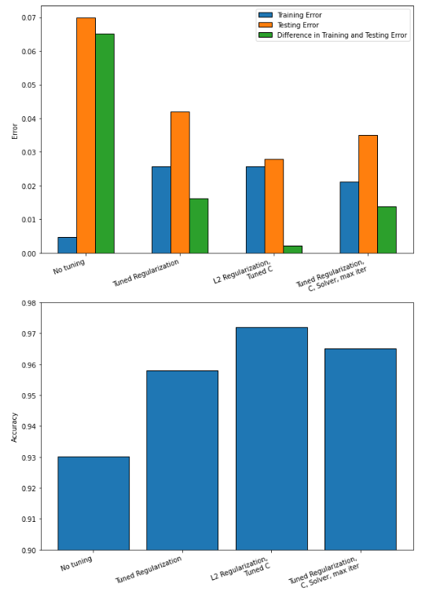
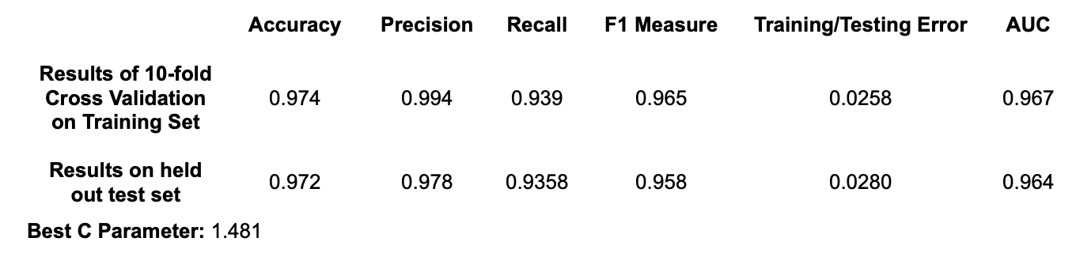
Logistic Regression - Dataset 1
Trained 4 classifiers with different tuned parameters sets
Best classifier: L2 regularization with Tuned C parameter
Highest accuracy (97.2%), lowest testing error, lowest bias, highest variance
Best Logisitic Regression Dataset 1 Classifier Metrics

Slide 5
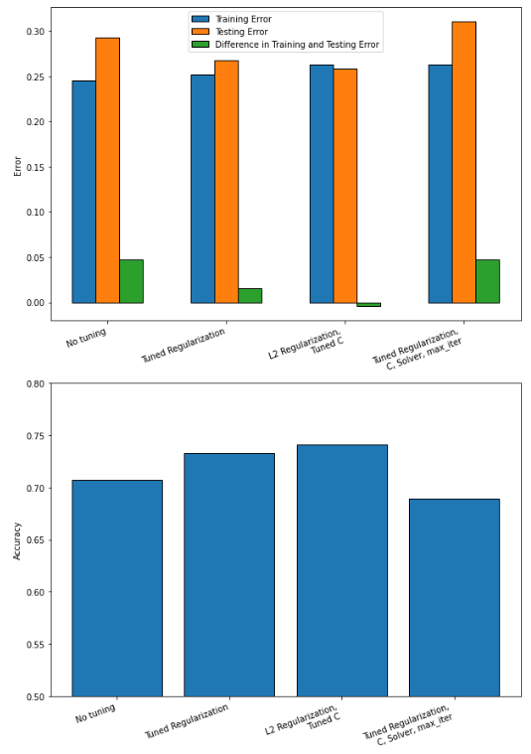
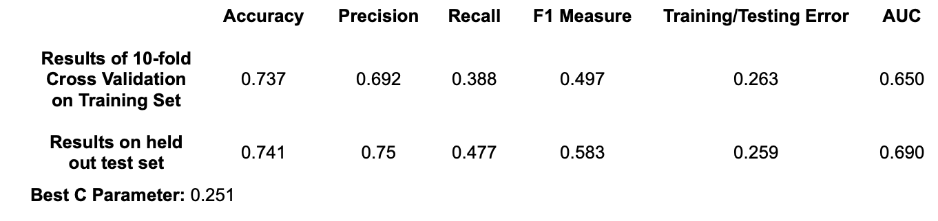
Logistic Regression - Dataset 2
Trained 4 classifiers with different tuned parameters sets
Best classifier: L2 regularization with Tuned C parameter
Highest accuracy (74.1%), lowest testing error, lowest bias, highest variance
Best Logisitic Regression Dataset 2Classifier Metrics

Slide 6
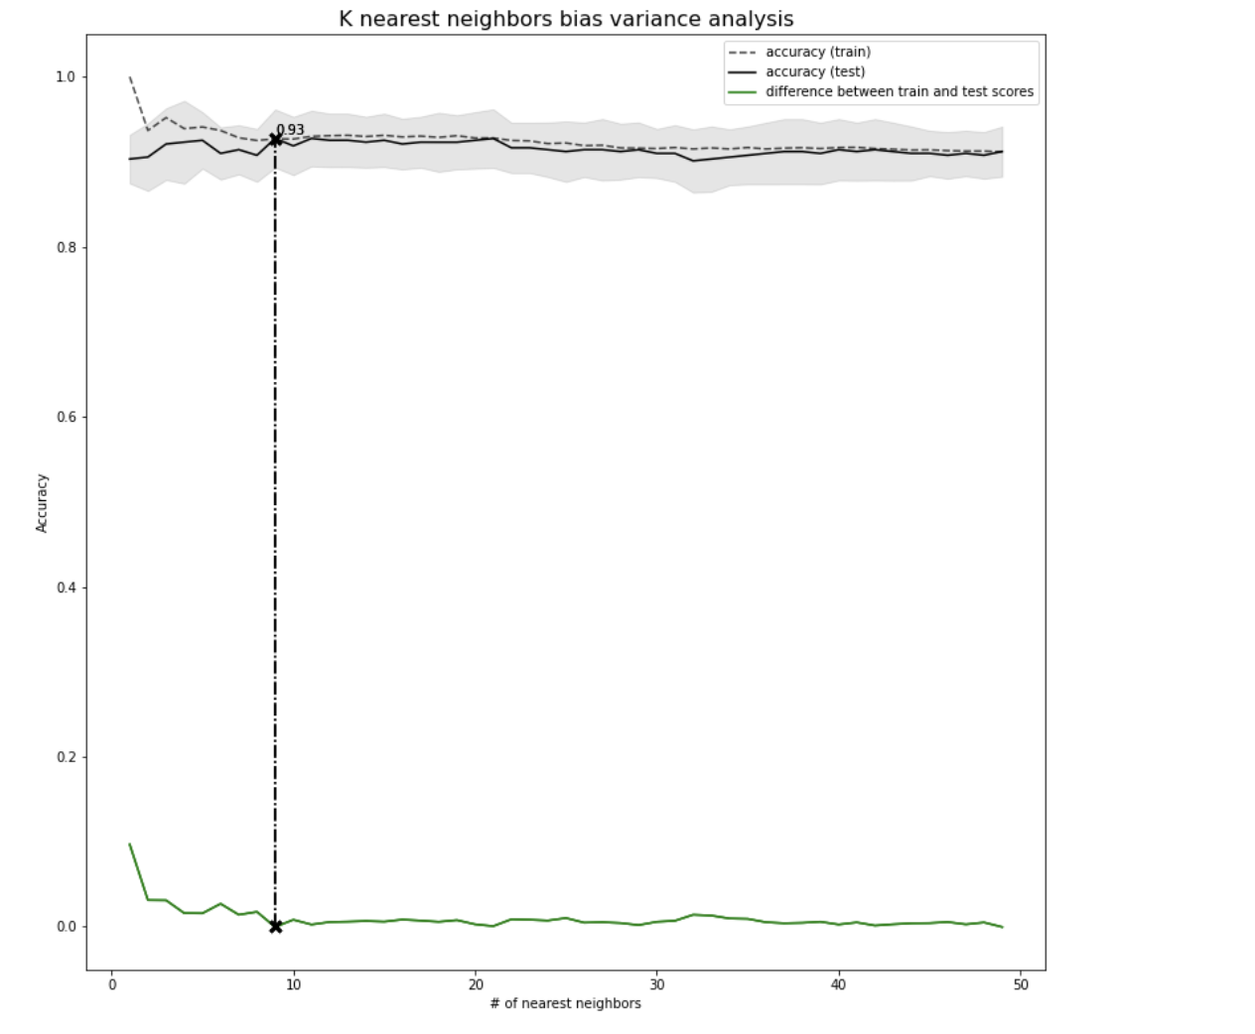
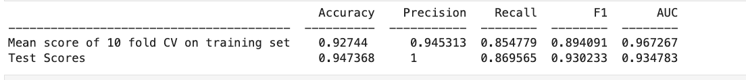
K Nearest Neighbors - Dataset 1

Slide 7
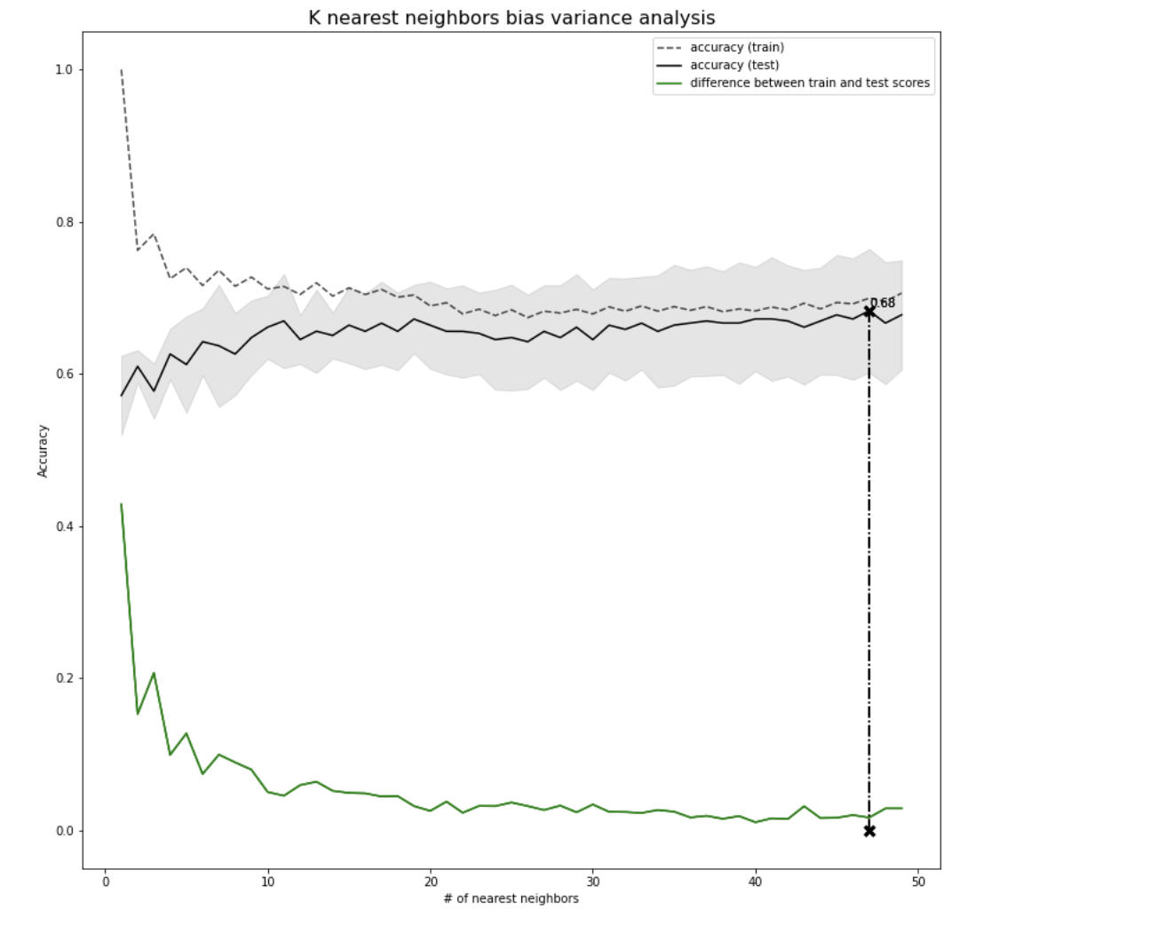
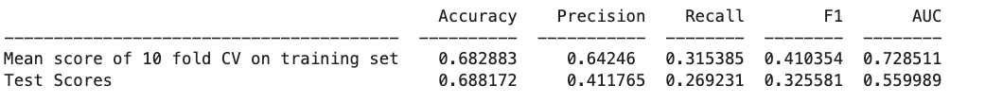
K Nearest Neighbors - Dataset 2

Slide 8
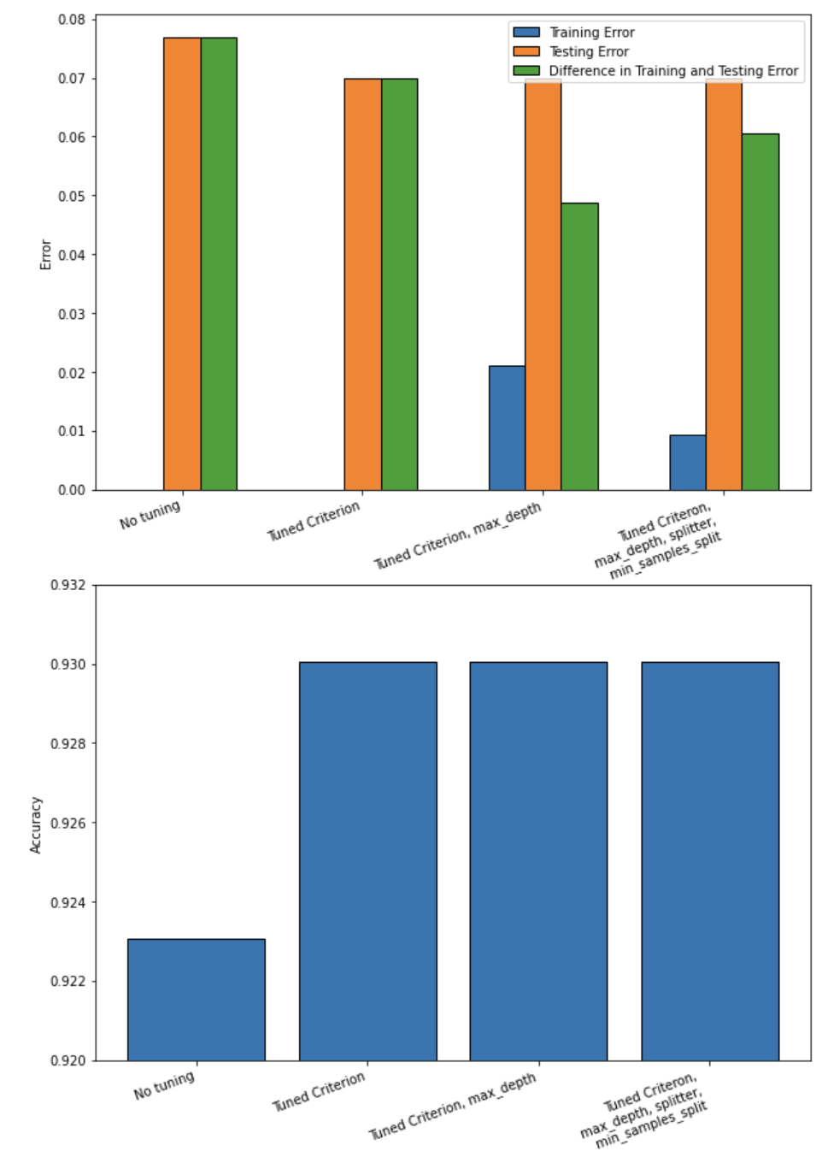
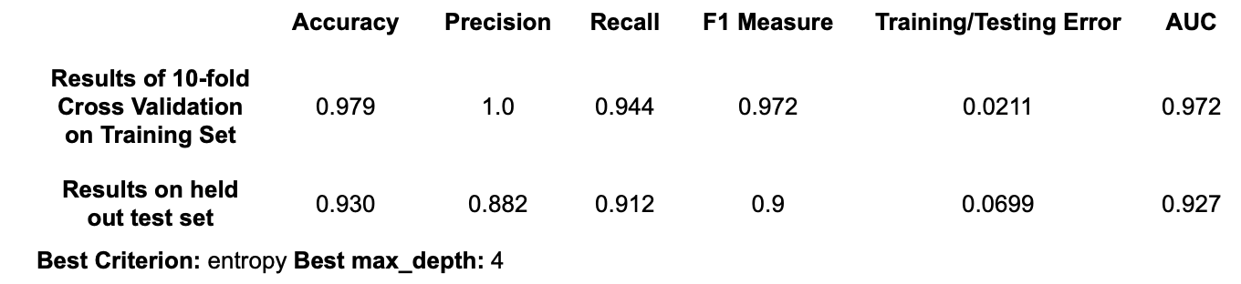
Decision Tree - Dataset 1
Trained 4 classifiers with different tuned parameters sets
Best classifier: tuned citerion/max_depth
Highest accuracy (93.0%), lowest testing error, lowest bias, highest variance
Best Decision Tree Dataset 1 Classifier Metrics

Slide 9
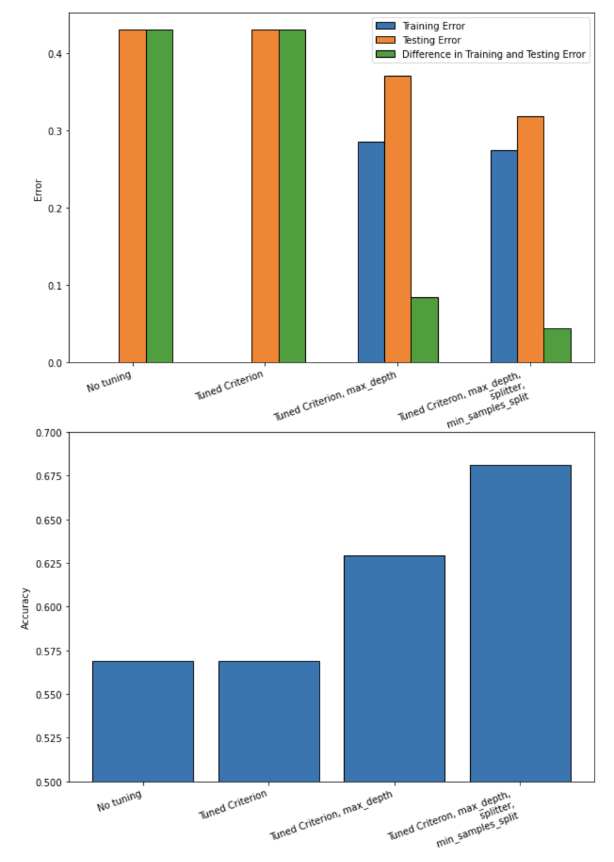
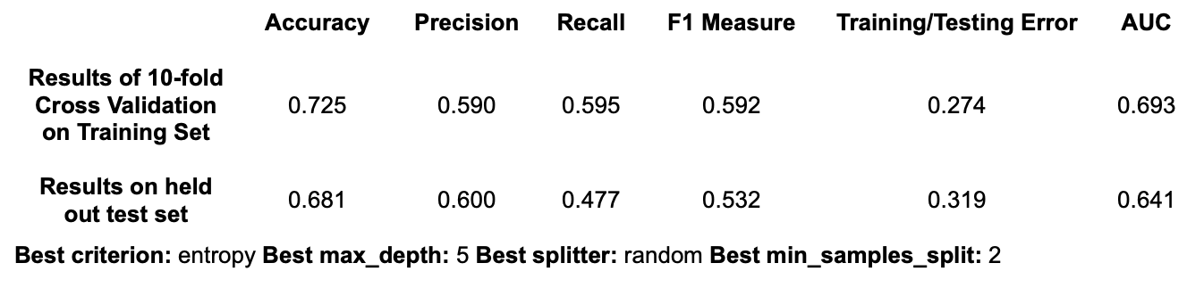
Decision Tree - Dataset 2
Trained 4 classifiers with different tuned parameters sets
Best classifier: tuned citerion, max_depth, splitter, min_samples_split
Highest accuracy (68.1%), lowest testing error, lowest bias, highest variance
Best Decision Tree Dataset 2 Classifier Metrics

Slide 10
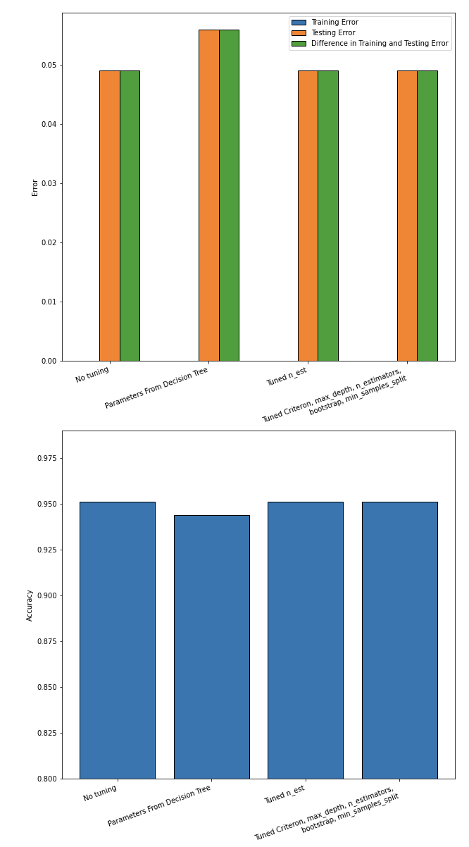
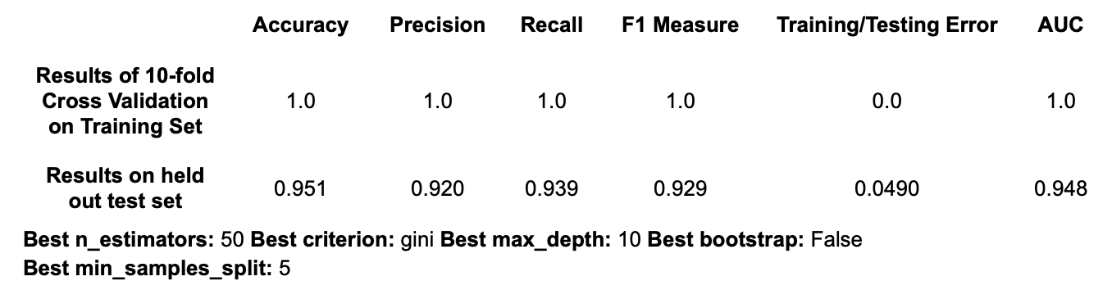
Random Forest - Dataset 1
Trained 4 classifiers with different tuned parameters sets
Best classifier: three way tie between default parameters, tuned n_estimator parameter, or tuned criterion, max_depth, n_estimators, bootstrap, min_samples_split
All reported the same metrics. Highest accuracy (95.1%), lowest testing error, lowest bias, highest variance
Example of Best Random Forest Dataset 1 Classifier Metrics (since there was a 3-way tie)

Slide 11
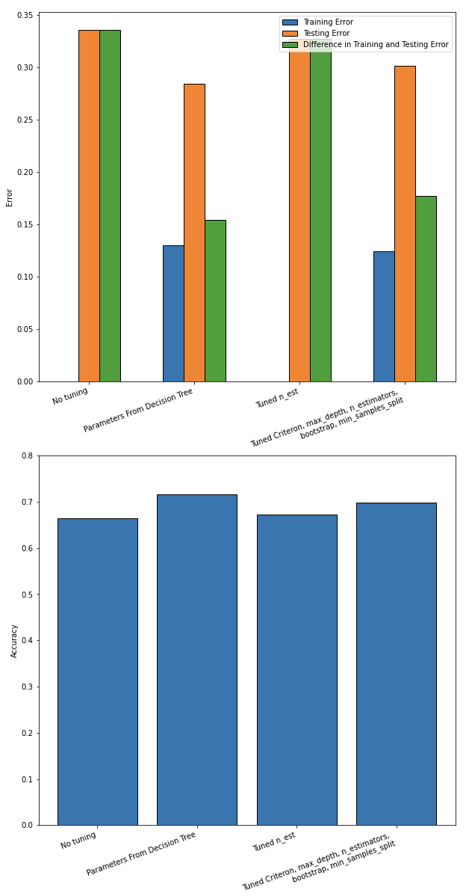
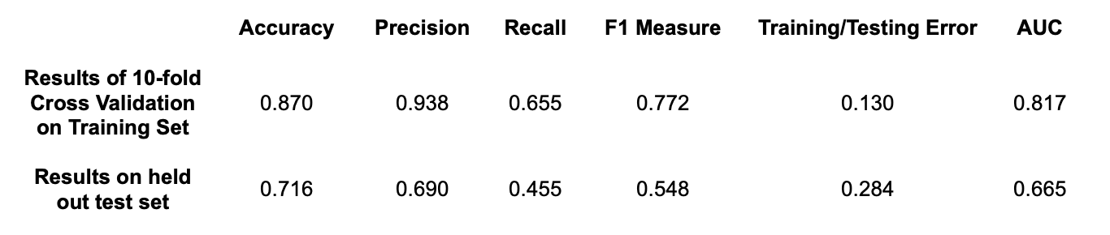
Random Forest - Dataset 2
Trained 4 classifiers with different tuned parameters sets
Best classifier: parameters from decision tree (criterion=entropy, max_depth = 5, min_samples_split = 2)
Highest accuracy (71.6%), lowest testing error, lowest bias, highest variance
Example of Best Random Forest Dataset 2 Classifier Metrics

Slide 12
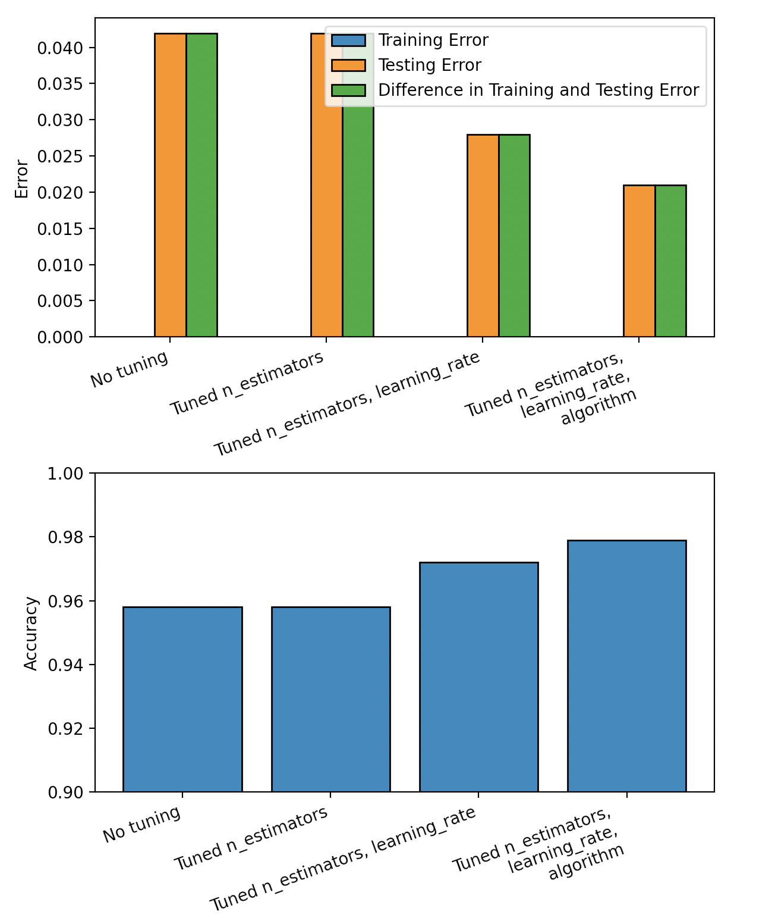
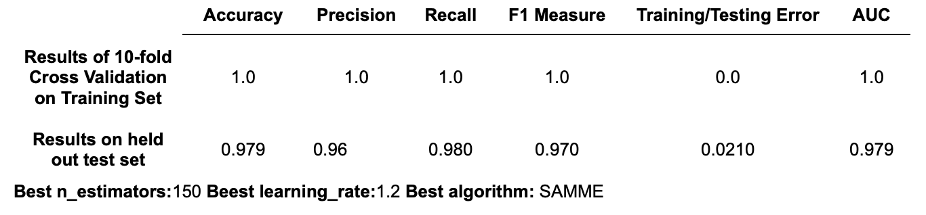
Boosting - Dataset 1
Trained 4 adaboost classifiers with different tuned parameters sets
Best classifier: tuned n_estimators, algorithm, and learning rate
Highest accuracy (97.9%), lowest testing error, lowest bias, highest variance
Best Adaboost Dataset 1 Classifier Metrics

Slide 13
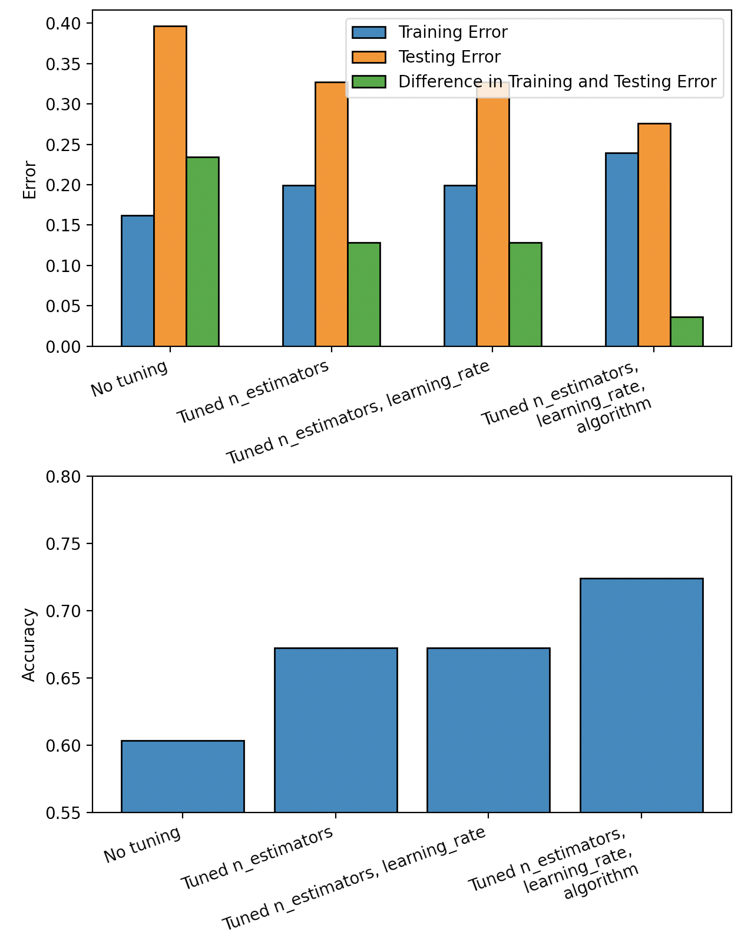
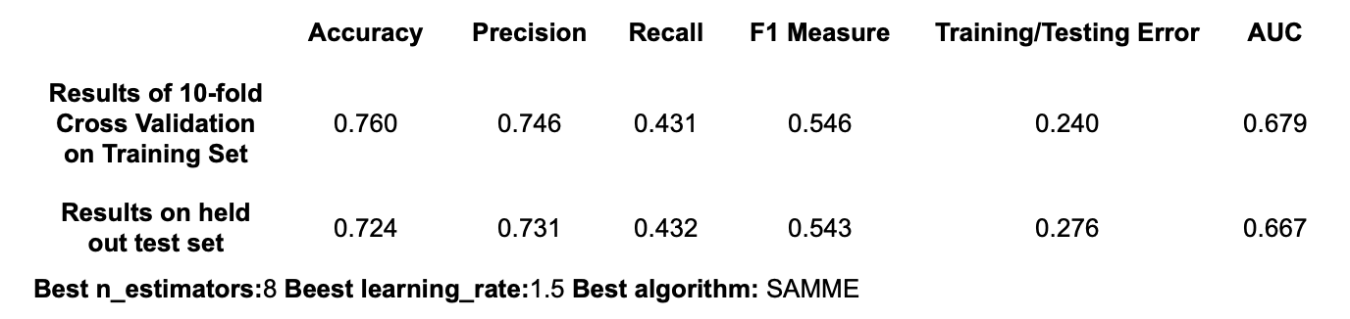
Boosting - Dataset 2
Trained 4 adaboost classifiers with different tuned parameters sets
Best classifier: tuned n_estimators, algorithm, and learning rate
Highest accuracy (72.4%), lowest testing error, lowest bias, highest variance
Best Adaboost Dataset 1 Classifier Metrics

Slide 14
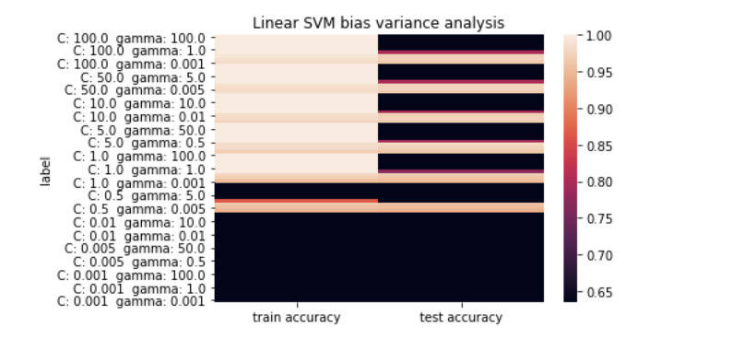
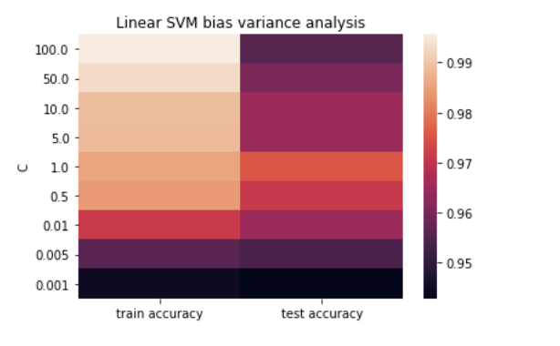
Support Vector Machines - Dataset 1

Slide 15
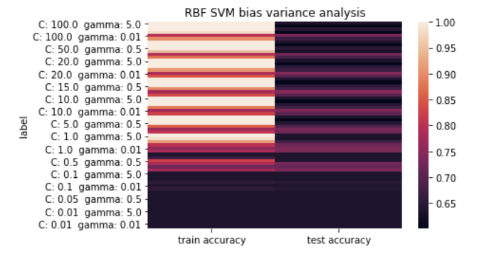
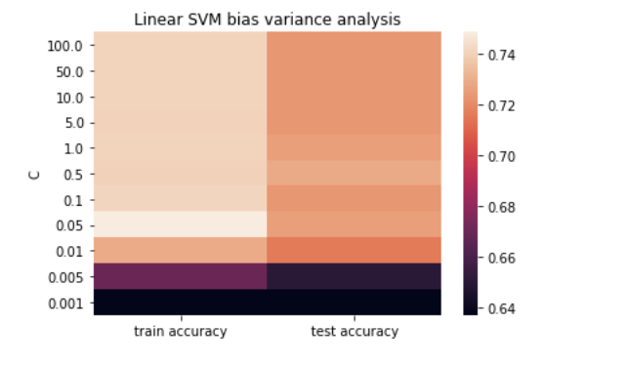
Support Vector Machines - Dataset 2

Slide 16
Best Overall Classifier - Dataset 1
The best overall classifier for dataset 1 was boosting with a test accuracy of 97.9% and a training accuracy of 100%

Slide 17
Best Overall Classifier - Dataset 2
The best overall classifier for dataset 2 was an rbf kernel SVM with a testing accuracy of 73.11% and a training accuracy of 74.5%

Slide 18
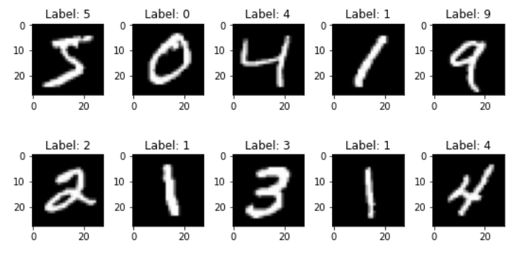
MNIST Dataset
MNIST (Modified National Institute of Standards and Technology) database
Images of handwritten numbers commonly used to train and benchmark various image processing methods.
Each image is 28x28
50,000 training images
10,000 test images
10,000 validation images (not used in this analysis)
Goal: Train a deep learning model to classify the 10 handwritten digits

Slide 19
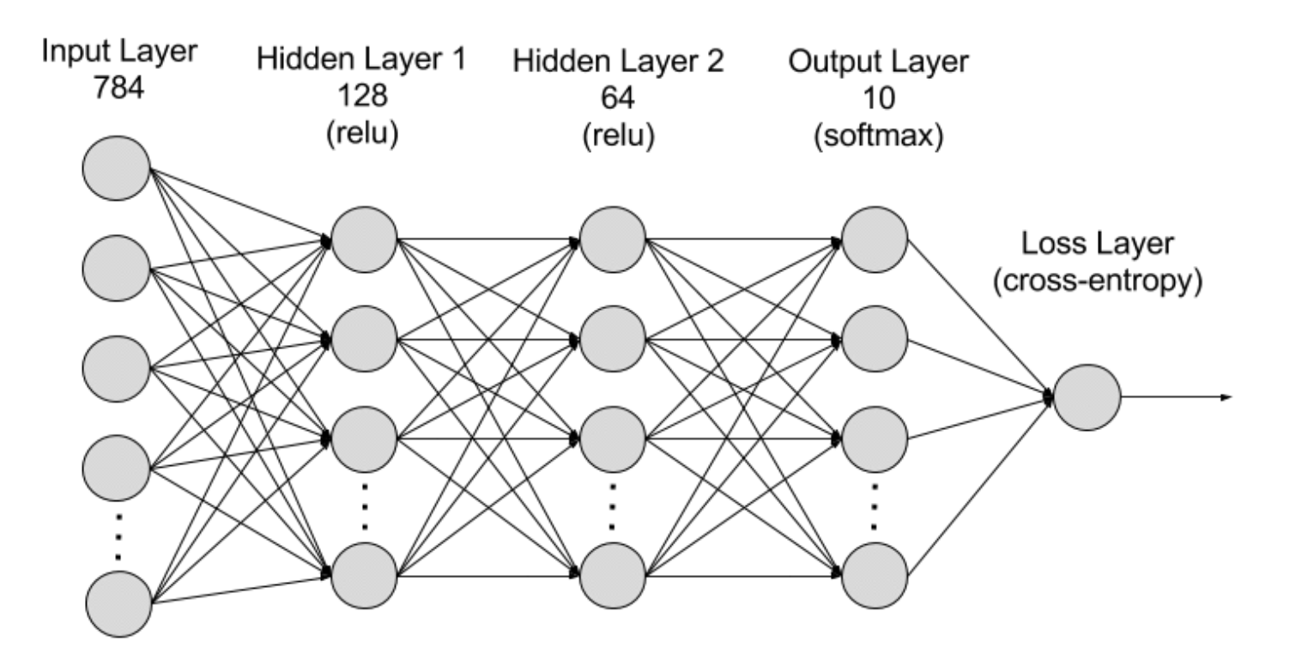
Deep Learning model - architecture
As its input, this model takes a flattened normalized image vector
It has 2 hidden layers using sigmoid activation functions
The number of hidden units were chosen after several rounds of parameter selection
It has a softmax output layer which generates a prediction.
300
150
Sigmoid
Sigmoid

Slide 20
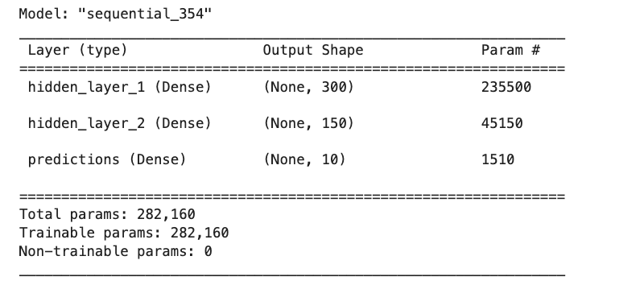
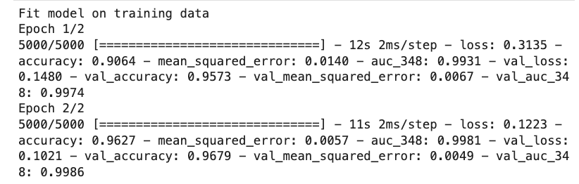
Deep Learning model: Results
Hyperparameters tested:
# of hidden units (first layer, second layer) (2,2), (10,10), (70,70), (150,150), (300,300), (300,150), (150,300)
Learning rates 1E-1, 1E-2, 5E-3, 1E-3, 5E-4, 1E-4, 1E-5, 1E-6, 5E-7
Initialization weights: Random uniform, random normal, glorot uniform, glorot normal, truncated normal, ones, zeros
Parameters chosen for final model:
# hidden units = (300,150)
Learning rate = 1E-3
Initialization weights = Glorot Uniform
For all models i trained

